Slide 1
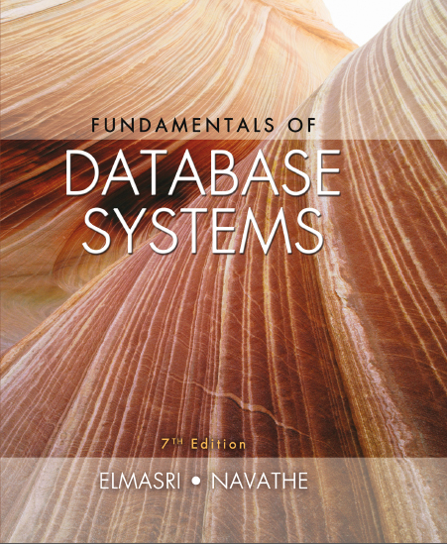
Fundamentals of Database Systems
Seventh Edition
Chapter 13
X M L: Extensible Markup Language
Slides in this presentation contain hyperlinks. JAWS users should be able to get a list of links by using INSERT+F7
Copyright © 2016, 2011, 2007 Pearson Education, Inc. All Rights Reserved
Notes:
If this PowerPoint presentation contains mathematical equations, you may need to check that your computer has the following installed:
1) MathType Plugin
2) Math Player (free versions available)
3) NVDA Reader (free versions available)

Slide 2
Introduction
Databases function as data sources for Web applications
H T M L
Used in static Web pages
X M L, J S O N
Self-describing documents
Dynamic Web pages
Chapter focus: X M L data model and languages

Slide 3
13.1 Structured, Semistructured, and Unstructured Data (1 of 2)
Structured data
Stored in relational database
Semistructured data
Not all data has identical structure
Schema information mixed in
Self-describing
Directed graph model
Unstructured data
Limited data type indication
Example: Web pages in H T M L

Slide 4
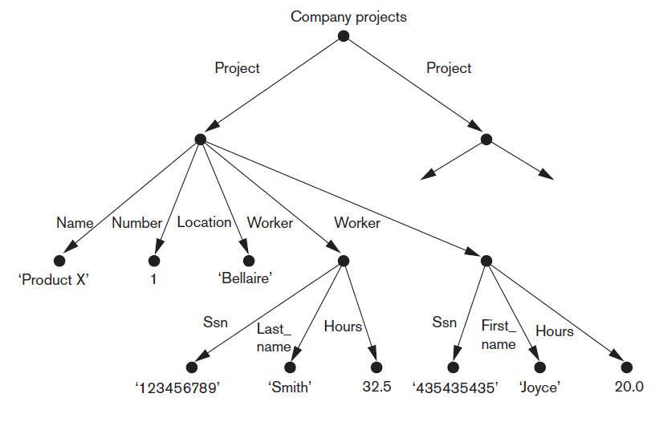
Directed Graph Model for Semistructured Data
Figure 13.1 Representing semistructured data as a graph

Slide 5
Structured, Semistructured, and Unstructured Data (2 of 2)
H T M L uses predefined tags
Document header
Script functions, formatting styles
Body
Table tags
Attributes
Large number of predefined tags
X H T M L
Extends tags for different applications

Slide 6
13.2 X M L Hierarchical (Tree) Data Model
Basic object: X M L document
Element
Simple
Complex
Schema document defines element names
Attribute
Document types
Data-centric
Document-centric
Hybrid

Slide 7
13.3 X M L Documents, D T D, and X M L Schema (1 of 4)
Conditions for well-formed X M L documents
Begins with X M L declaration
Syntactically correct
Valid
Must follow a particular schema

Slide 8
13.3 X M L Documents, D T D, and X M L Schema (2 of 4)
Notation for specifying elements
elementname* indicates optional multivalued (repeating) element
elementname+ indicates required multivalued (repeating) element
elementname? indicates optional single-valued (non-repeating) element
elementname indicates required single-valued (non-repeating) element

Slide 9
13.3 X M L Documents, D T D, and X M L Schema (3 of 4)
Notation for specifying elements
Type specified by parentheses following the element name
!A T T LIST used to specify attributes within the element
Parentheses can be nested when specifying elements
Bar symbol
indicates either e₁ or e₂ can appear in the document

Slide 10
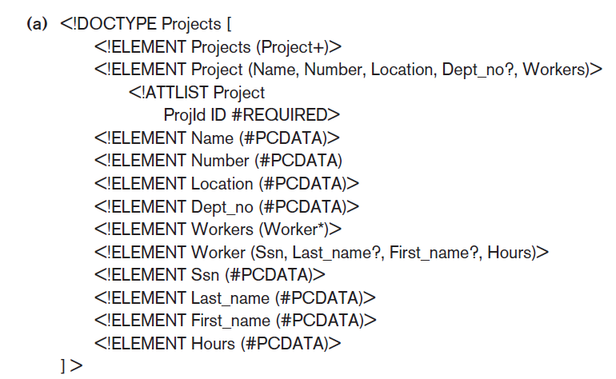
13.3 X M L Documents, D T D, and X M L Schema (4 of 4)
Figure 13.4(a) An X M L D T D file called ‘Projects’

Slide 11
X M L Schema (1 of 3)
X M L schema language
Specifies document structure
Same syntax rules as X M L documents
Elements, attributes, keys, references, and identifiers
Example: Figure 13.5 in the text

Slide 12
X M L Schema (2 of 3)
X M L namespace
Defines set of commands that can be used
Annotations, documentation, and language used
Elements and types
Root element
First-level elements
Specifying element type and min and max occurrences

Slide 13
X M L Schema (3 of 3)
Keys
Constraints that correspond to relational database
Primary key
Foreign key
Complex elements
x s d:complexType
Composite (compound) attributes

Slide 14
13.4 Storing and Extracting X M L Documents from Databases
Use file system or D B M S to store documents as text
Use D B M S to store document contents as data elements
Design specialized system to store X M L data
Create or publish custom X M L documents from preexisting relational databases
This approach explored further in 13.6

Slide 15
13.5 X M L Languages
Query language standards
XPath
XQuery
Specifying XPath expressions in X M L
Returns sequence of items satisfying certain pattern
Values, elements, or attributes
Qualifier conditions
Separators
Single slash / or double slash //

Slide 16
XPath (1 of 2)
Example
For COMPANY.X M L document stored at location www.company.com/info.XML
doc(www.company.com/infor.XML)/company returns company root node and all descendant nodes

Slide 17
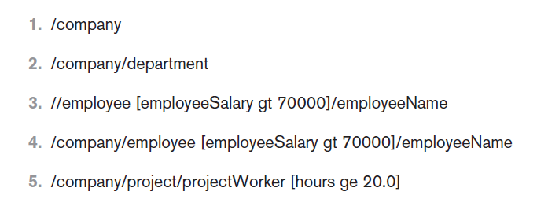
XPath (2 of 2)
Figure 13.6 Some examples of XPath expressions on X M L documents that follow the X M L schema file company in Figure13.5.

Slide 18
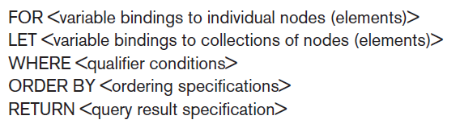
XQuery: Specifying Queries in X M L (1 of 2)
F L W O R expression
Variables preceded with $
For assigns variable to a range
Where specifies additional conditions
Order by specifies order of result elements
Return specifies elements for retrieval

Slide 19
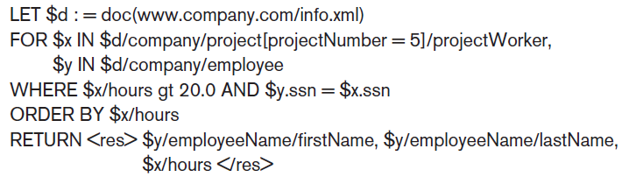
XQuery: Specifying Queries in X M L (2 of 2)
Example

Slide 20
Other Languages and Protocols Related to X M L
Extensible Stylesheet Language (X S L)
Extensible Stylesheet Language for Transformations (X S L T)
Web Services Description Language (W S D L)
Simple Object Access Protocol (S O A P)
Resource Description Framework (R D F)

Slide 21
13.6 Extracting X M L Documents from Relational Databases
X M L uses hierarchical (tree) model
Common database model is flat relational database
Conceptually represent using E R schema
University example (follows)
Choices for root: course, student, section

Slide 22
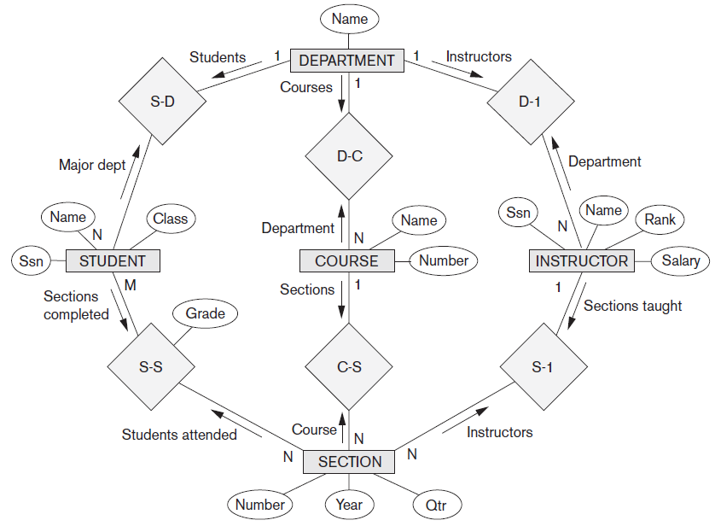
University Example (1 of 6)
Figure 13.8 An E R schema diagram for a simplified UNIVERSITY database

Slide 23
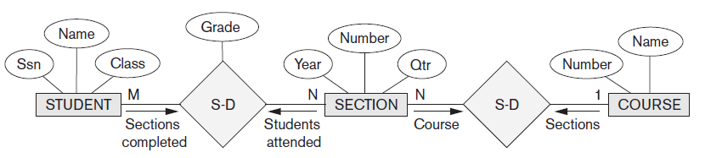
University Example (2 of 6)
Figure 13.9 Subset of the UNIVERSITY database schema needed for X M L document extraction

Slide 24
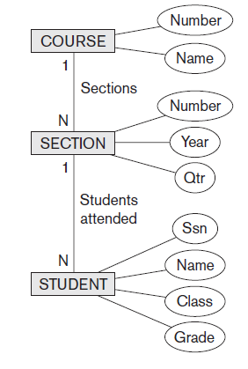
University Example (3 of 6)
Figure 13.10 Hierarchical (tree) view with ‘COURSE’ as the root

Slide 25
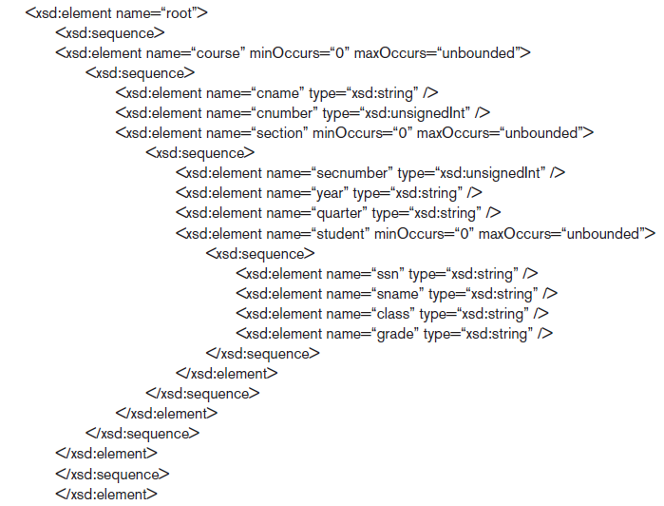
University Example (4 of 6)
Figure 13.11 X M L schema with ‘COURSE’ as the root

Slide 26
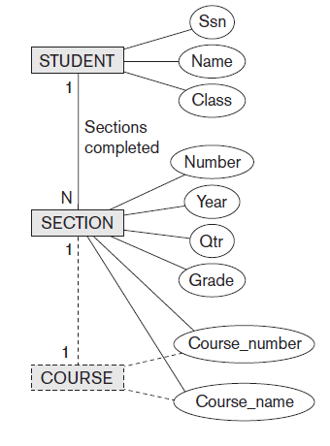
University Example (5 of 6)
Figure 13.12 Hierarchical (tree) view with ‘STUDENT’ as the root

Slide 27
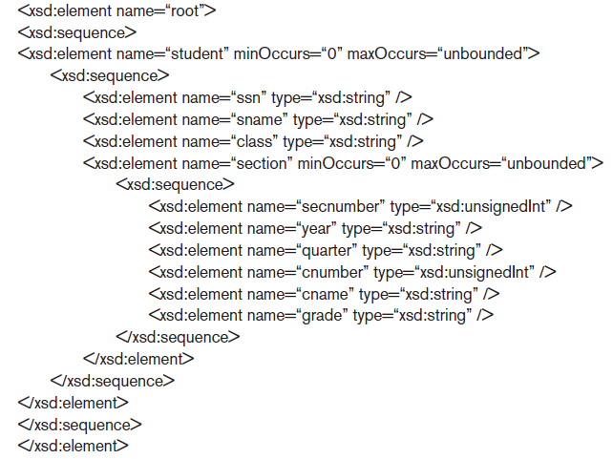
University Example (6 of 6)
Figure 13.13 X M L schema document with ‘STUDENT’ as the root

Slide 28
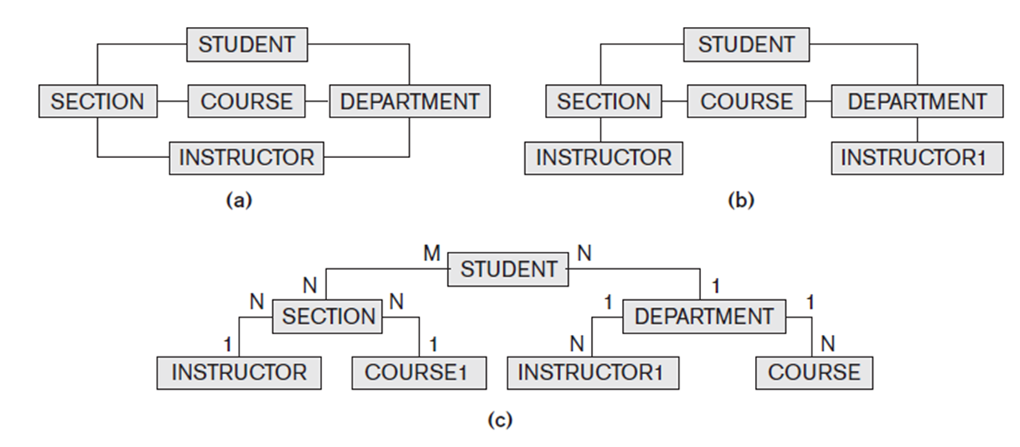
Breaking Cycles to Convert Graphs into Trees

Slide 29
Other Steps for Extracting X M L Documents from Databases
Create S Q L query to extract desired information
Execute the query
Restructure from flat to tree structure
Customize query to select single or multiple objects into the document

Slide 30
13.7 X M L/S Q L: S Q L Functions for Creating X M L Data (1 of 2)
X M L ELEMENT
Specifies tag (element) name that will appear in X M L result
X M L FOREST
Specifies multiple element names
X M L A G G
Aggregate several elements
X M L ROOT
Selected elements formatted as X M L document with single root element

Slide 31


13.7 X M L/S Q L: S Q L Functions for Creating X M L Data (2 of 2)
X M L ATTRIBUTES
Creates attributes for the elements of the X M L result
Example: create X M L element containing the EMPLOYEE lastname for the employee with S S N 123456789
Result:

Slide 32
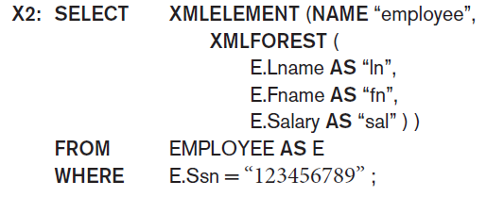
Employee Example (Query 2)
To retrieve multiple columns for a single row:
Result:

Slide 33
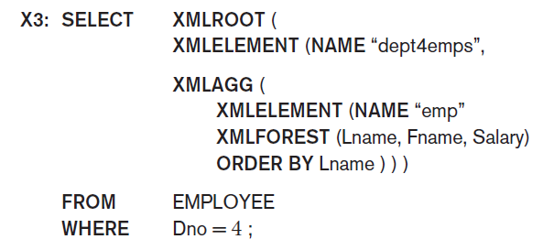
Employee Example (Query 3) (1 of 2)
To create X M L document with last name, first name, and salary of employees from Dept. 4:

Slide 34
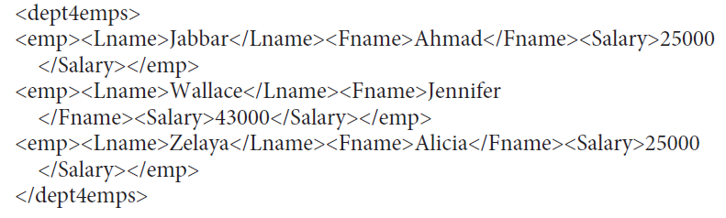
Employee Example (Query 3) (2 of 2)
Result:

Slide 35
13.8 Summary
Structured, semistructured, and unstructured data
Hierarchical data model of X M L standard
Languages for specifying structure
X M L D T D and X M L schema
Approaches for storing X M L documents
XPath and XQuery languages
Mapping issues
S Q L/X M L allows formatting query results as X M L data

Slide 36

Copyright

